Slide 1



Car Pricing Analysis Project
Web scraping, SQL, Excel, Python

Slide 2

Steps for analysing the car data
Introduction to the Project
Excel Dashboard Development
Key Insights and Recommendations
Web Scraping Process
SQL Data Extraction and Analysis

Slide 3
Introduction to the Project
In this project, we will apply our skills in web scraping, data cleaning, SQL, EDA, Excel, and PowerPoint to perform a comprehensive car pricing analysis using data from Cars24. We are required to scrape data from the Cars24 website for two different metro locations, analyze the data, and present our findings through a dynamic Excel dashboard and a PowerPoint presentation.

Slide 4
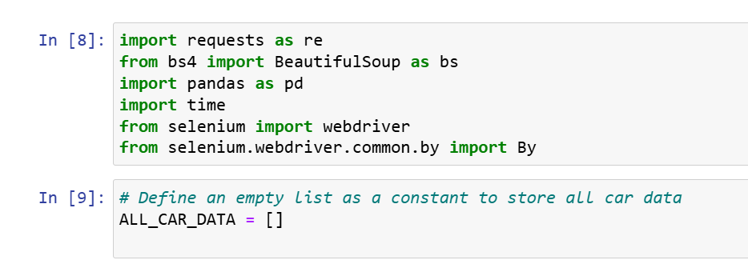
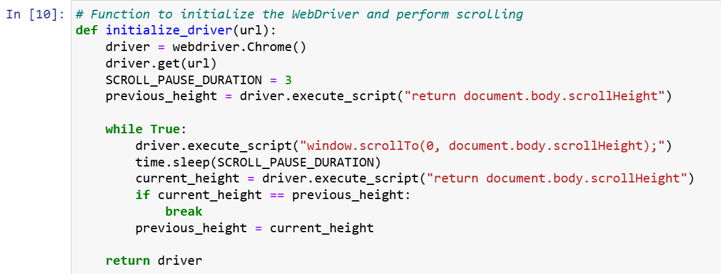
Web Scraping Process:

Slide 5
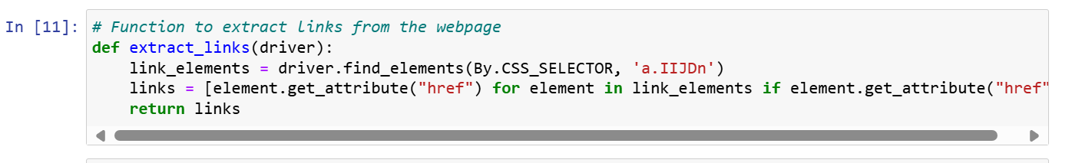
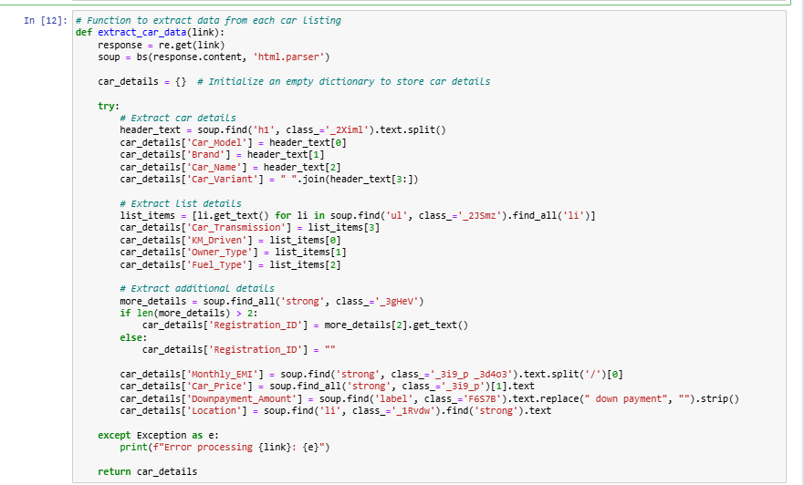
Web Scraping Process:

Slide 6
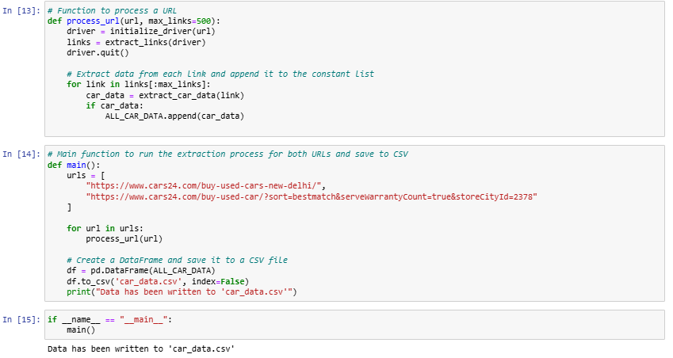
Web Scraping Process:

Slide 7
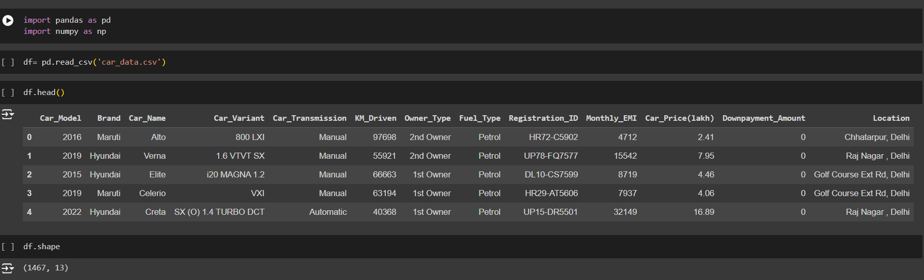
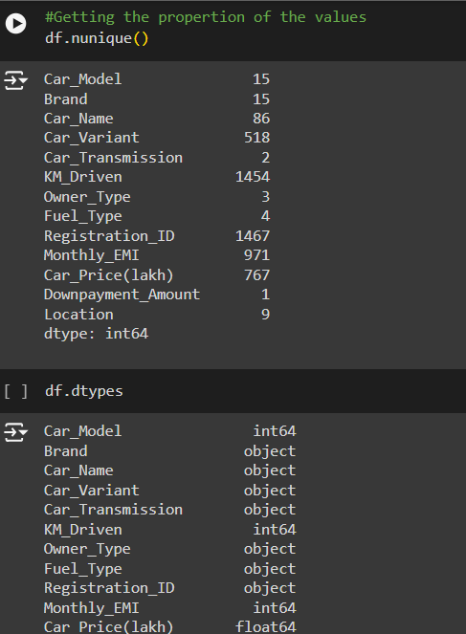
SQL Data Extraction and data cleaning:

Slide 8
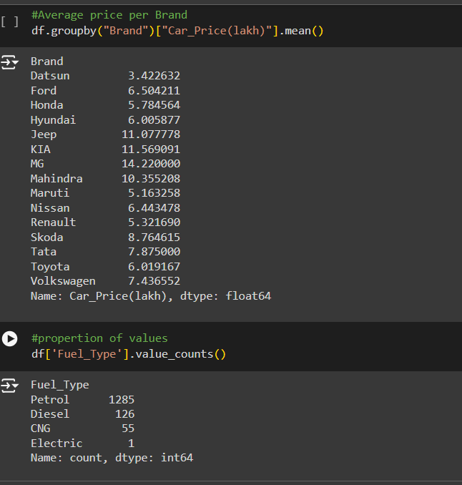
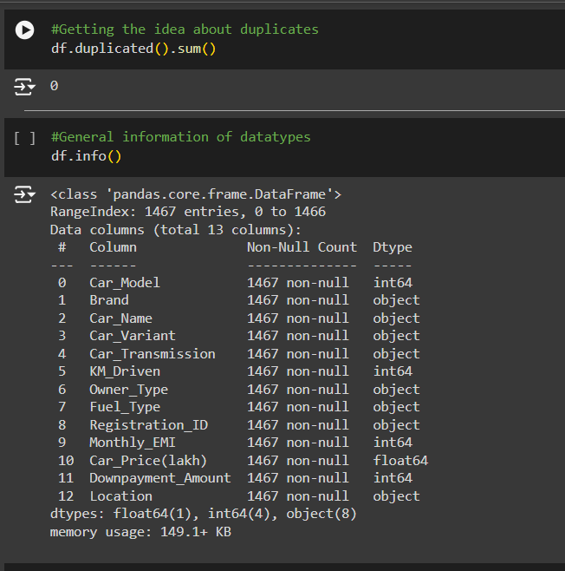
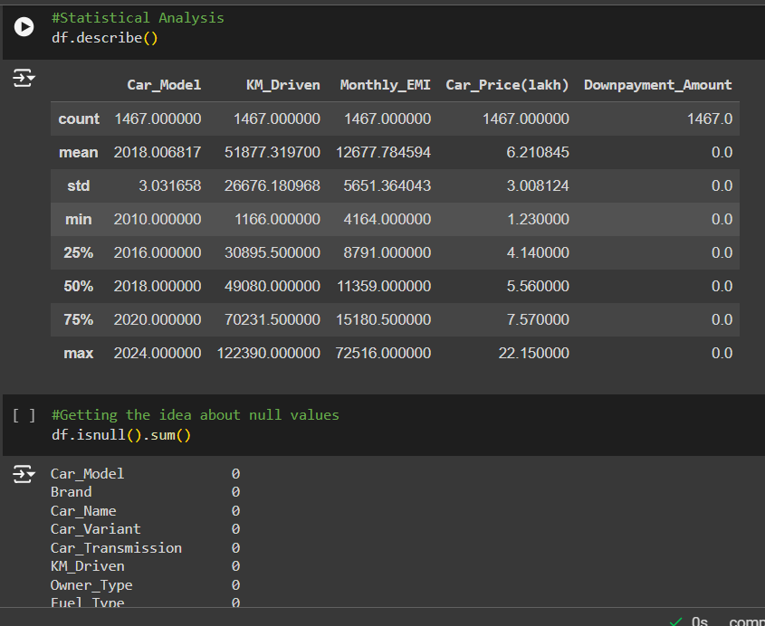
SQL Data Extraction and data cleaning:

Slide 9
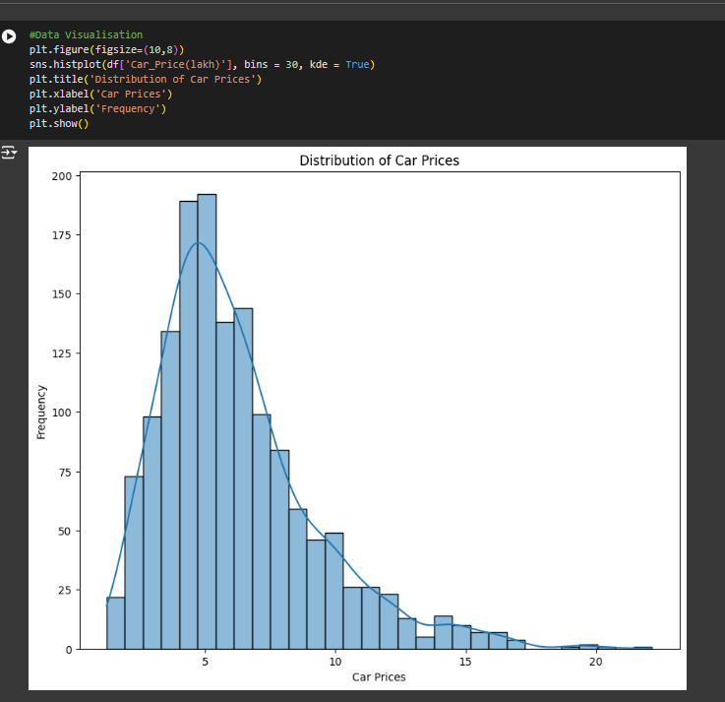
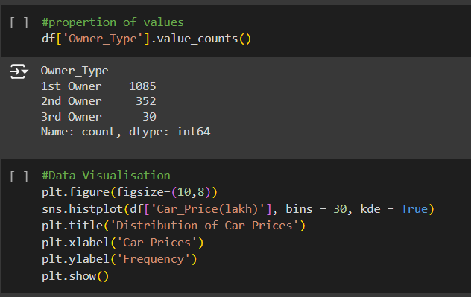
SQL Data Extraction and data cleaning:

Slide 10
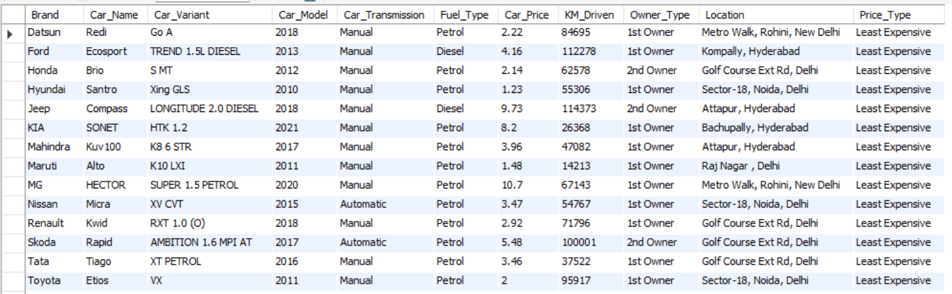
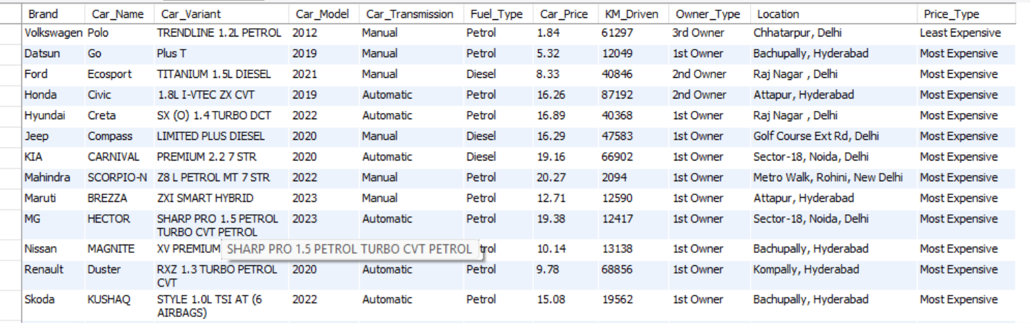
SQL Data Extraction and data cleaning:
Finding the least and most expensive cars for each brand along with their specifications

Slide 11
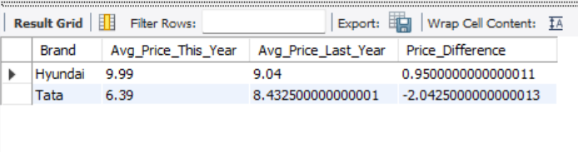
SQL Data Extraction and data cleaning:
Comparison of the average prices of cars from each brand this year to those from last year

Slide 12
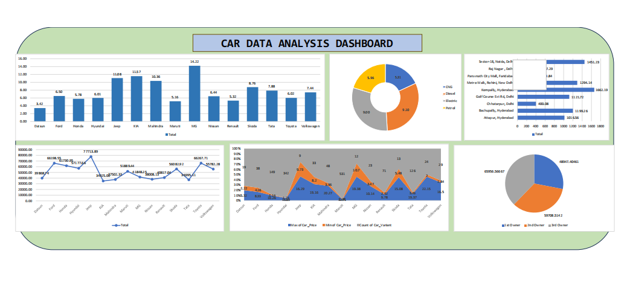
Excel Dashboard Development:

Slide 13
Key Insights and Recommendations
From Sql Data Extraction we found the Least Expensive car is from "Maruti" brand that Costs around 1.23Lakhs and the most expensive car is from "Toyota" Brand which costs around 22.15lakhs
Excel Dashboard shows that the "MG" brand car has highest selling average price costing around 14lakhs.
The Cars having fuel type "Disel" is of having highest percentage compared to total average car price in the market
i.e. 31% and average price is 9.10lakhs.
Comparing the owner type of the car the "3rd Owners" have drove maximum distance in kilometer which is 38% of the total owners.
Only Recommendation is that adjust the price of the cars so that the 1st owner, the customer living in place like delhi, faridabad can will buy thinking of it's good condition and pricing; that will increase the company sales and also profit accordingly.

